Slide 1
First Day Information

Slide 2
Where am I?
PSY 745
Mondays 12:20-2:20
Labs:
W 12:20-2:20
W 2:35-4:35

Slide 3
Who is this person?
Dr. B
Dr. Buchanan (only if you spell it right)
NOT
Ms or Mrs anything

Slide 4

Who is this person?
http://aggieerin.com or follow the DOOM lab on Twitter @aggieerin

Slide 5

Who is this person?

Slide 6

Who is this person?

Slide 7
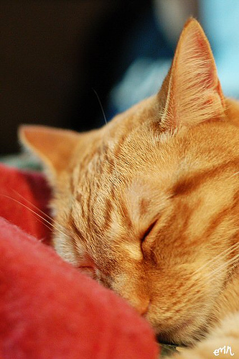
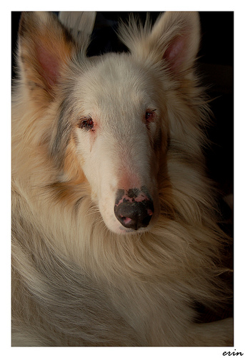
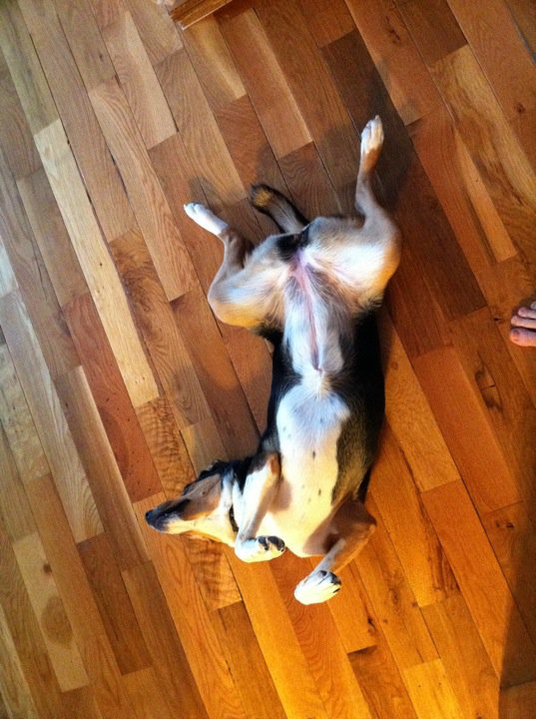
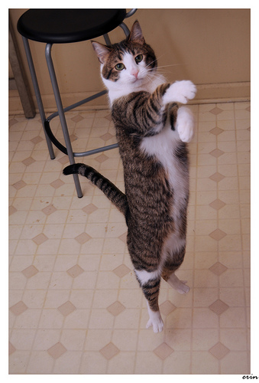
Who is this person?

Slide 8
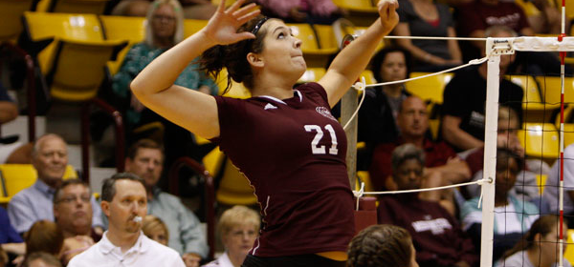
Who is this person?

Slide 9
Office
Hill Hall 214D
Hill Hall 460

Slide 10
Contact
Office hours:
MW 11-12PM
Email
erinbuchanan@missouristate.edu

Slide 11
Help Hours
Rachel Monroe!
Sam Hunter!
Hours:
TBA!
Help Desk Blackboard!

Slide 12
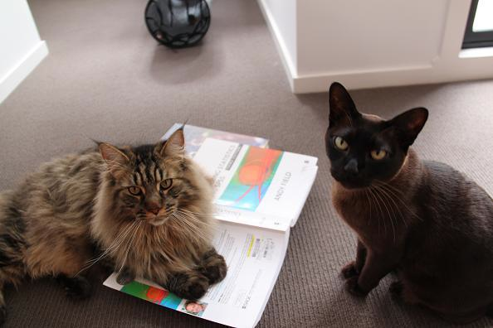
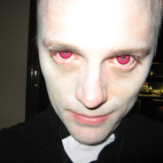
Book

Slide 13

Blackboard
ALL THE THINGS!

Slide 14
Assignments
Practice the stuff we learn in class (25%)
You can work together
You will turn in R syntax
You will learn how to write (oh no!)

Slide 15
Exams
Three exams (60%)
Each exam has a take home and in class portion
Stats is cumulative, but the exams are not purposely cumulative.
You must work on these individually.

Slide 16
Labs
Labs! (15%)
We will practice things in class, which you will complete and get credit for.
Note about the labs: do them in lab or get a zero.

Slide 17
Late Policy
Dude, this is graduate school.
Be serious.
Ok, fine 25% off per day.

Slide 18

Make Up Policy

Slide 19

Classroom Policy

Slide 20
Schedule
Look at that schedule!
Isn’t it cute?!
We’ll see if it works!

Slide 21
Now let’s do stuff
Chapter 1

